Slide 1
CampusLink
A decentralized wireless system for reliable campus communication
MENTOR
TEAM
Dr.Shivashankara S
Associate prof,Dept of CSE
GEC KR Pet
Arjun M
M Rajeswar

Slide 2
Maverick
Project Objective
Main Goal
To create a simple, reliable communication system that allows users to send and receive messages through text-to-text and speech-to-speech without depending heavily on the internet.
Supporting Objectives
  Designing a simple and user-friendly interface for mobile and desktop use
  Designing an efficient text-to-text and speech-to-speech communication system
  Designing a lightweight system that works offline with minimal distractions
CampusLink
1

Slide 3


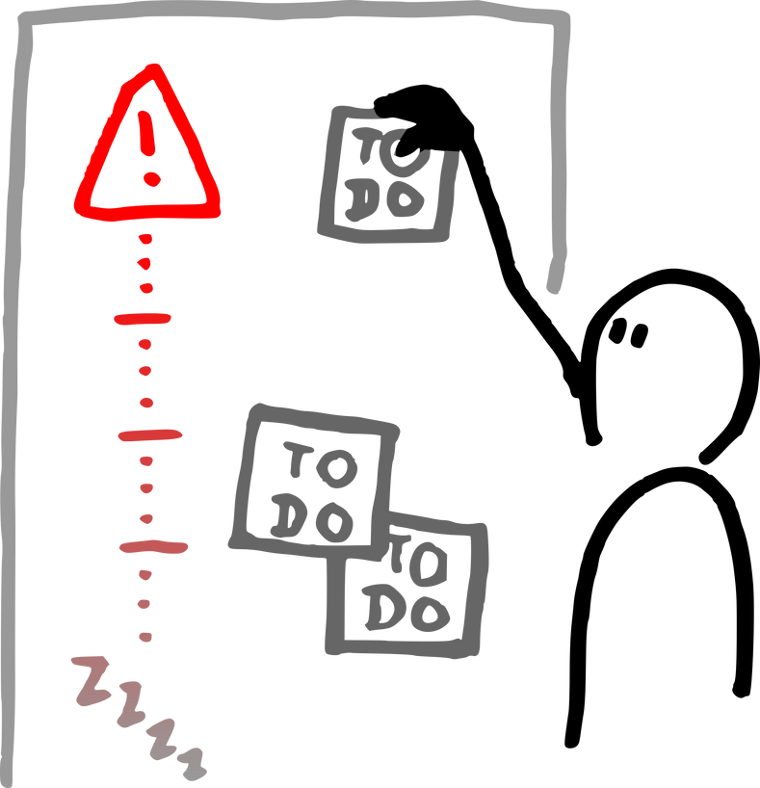
Maverick
Project Overview
Problem
Solution
Why It Matters
We noticed that campus systems rely mainly on the internet for communication, which causes delays, poor connectivity, and security risks when the network is unstable.
We are developing a secure ESP32 and LoRa-based system that enables long-range, low-power communication without depending on internet connectivity.
This improves reliability, and ensures continuous communication even during internet outages.
CampusLink
2

Slide 4
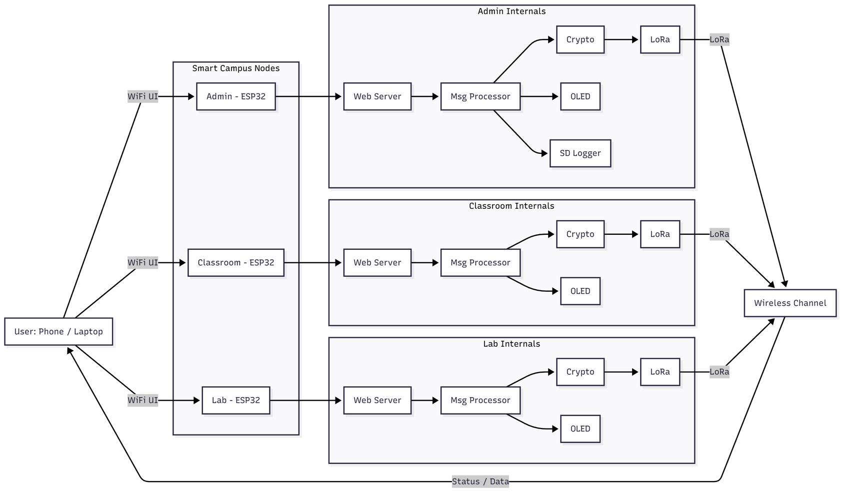
Maverick
System Architecture
CampusLink
3

Slide 5


Maverick
Who We Designed For
Target User
Their Challenges
College and university staff, administrators, who need fast, reliable communication between classrooms, laboratories, and administrative blocks for announcements and emergency alerts.
  Mainly rely on internet-based communication systems
  Face delays when the internet is slow or unavailable
  Miss important announcements due to network failures
  Lack reliable real-time communication between campus sections
CampusLink
5
4

Slide 6

Maverick
TEAM A
Arjun M
M Rajeswar
CampusLink

